Slide 1
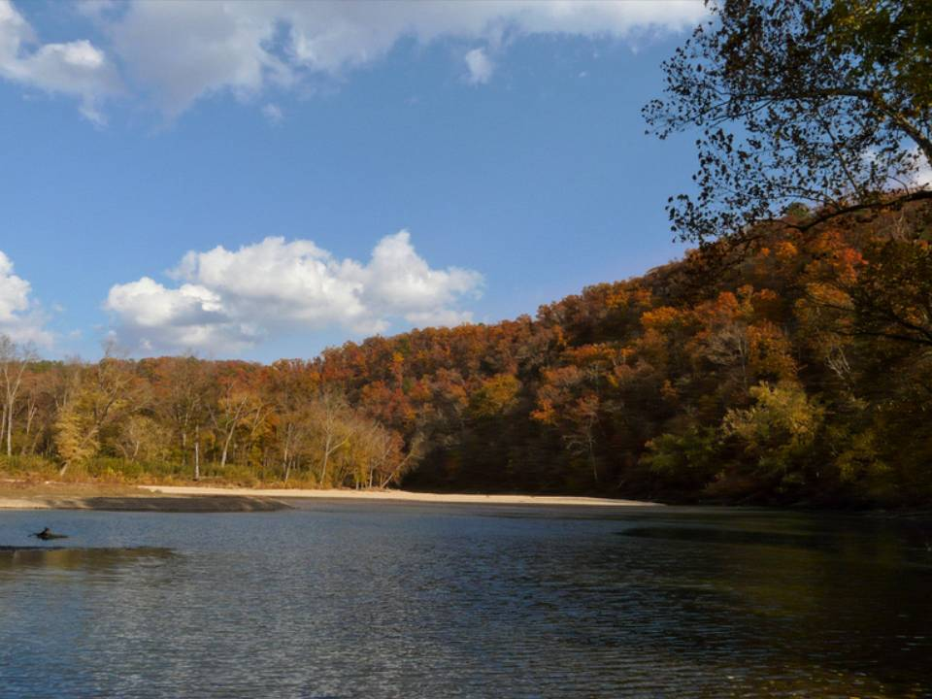
Water Quality Monitoring and Constituent Load Estimation in the Upper Illinois River Watershed, 2009
Brian E. Haggard
Director,
Arkansas Water Resources Center
Funding provided by ANRC through the Illinois River Watershed Partnership

Slide 2
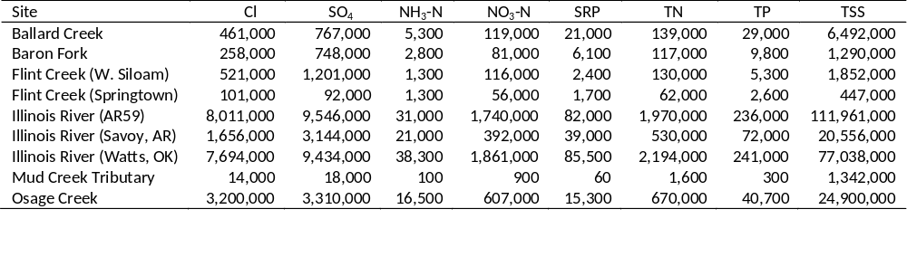
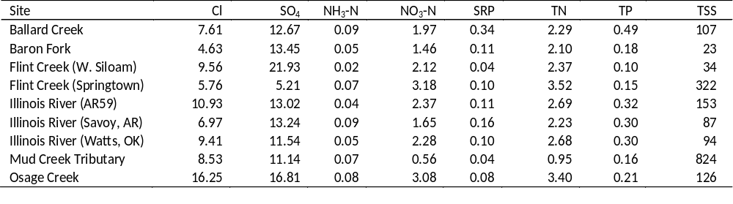
2009 Summary
Loads and Flow-Weighted Concentrations

Slide 3
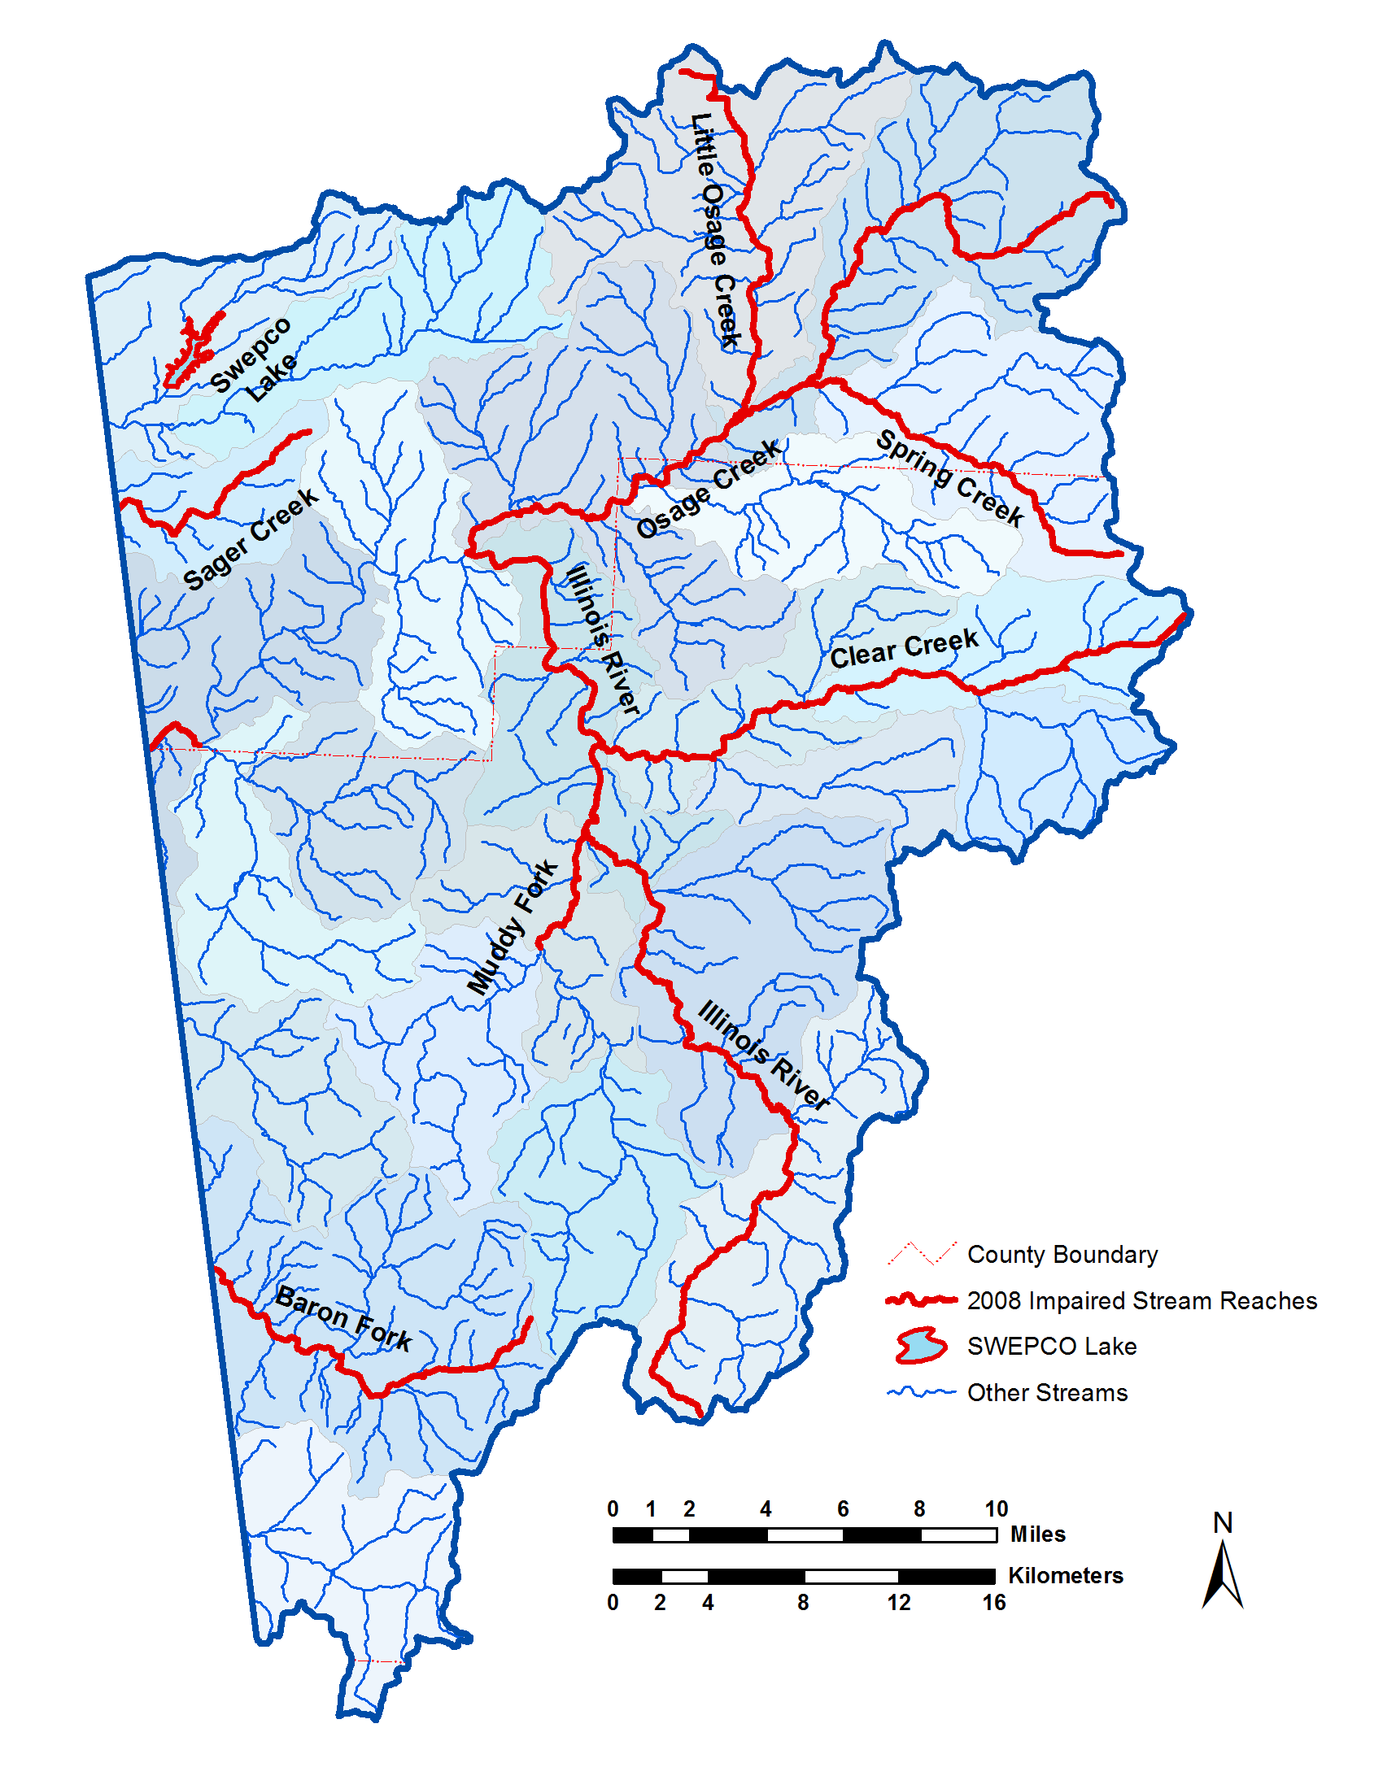
Water samples were collected at seven sites in the UIRW.
Stage recorded in 30 minute intervals by USGS to estimate discharge.
Water samples were collected once a week and storm events were targeted
Water samples were analyzed at the AWRC WQL for:
  Chloride
  Sulfate
  Nitrate-N
  Ammonia-N
  Soluble reactive P
  Total N
  Total P
  Total Suspended Solids
Osage Creek
Flint Creek
Mud Creek
IR@59
IR@Savoy
Ballard Creek
Baron Fork

Slide 4
Load Determination
Linear regression was used to determine the relationship between daily load and daily flow:
  ln(L_{d}) = β_{o} + β₁ln(Q_{d}) —or—
  ln(L_{d}) = β_{o} + β₁ln(Q_{d}) + β₂sin(2πT) + β₃cos(2πT)
BCF was used to remove bias from log transformations:
BCF= | ∑e^{r}
 | n

Slide 5
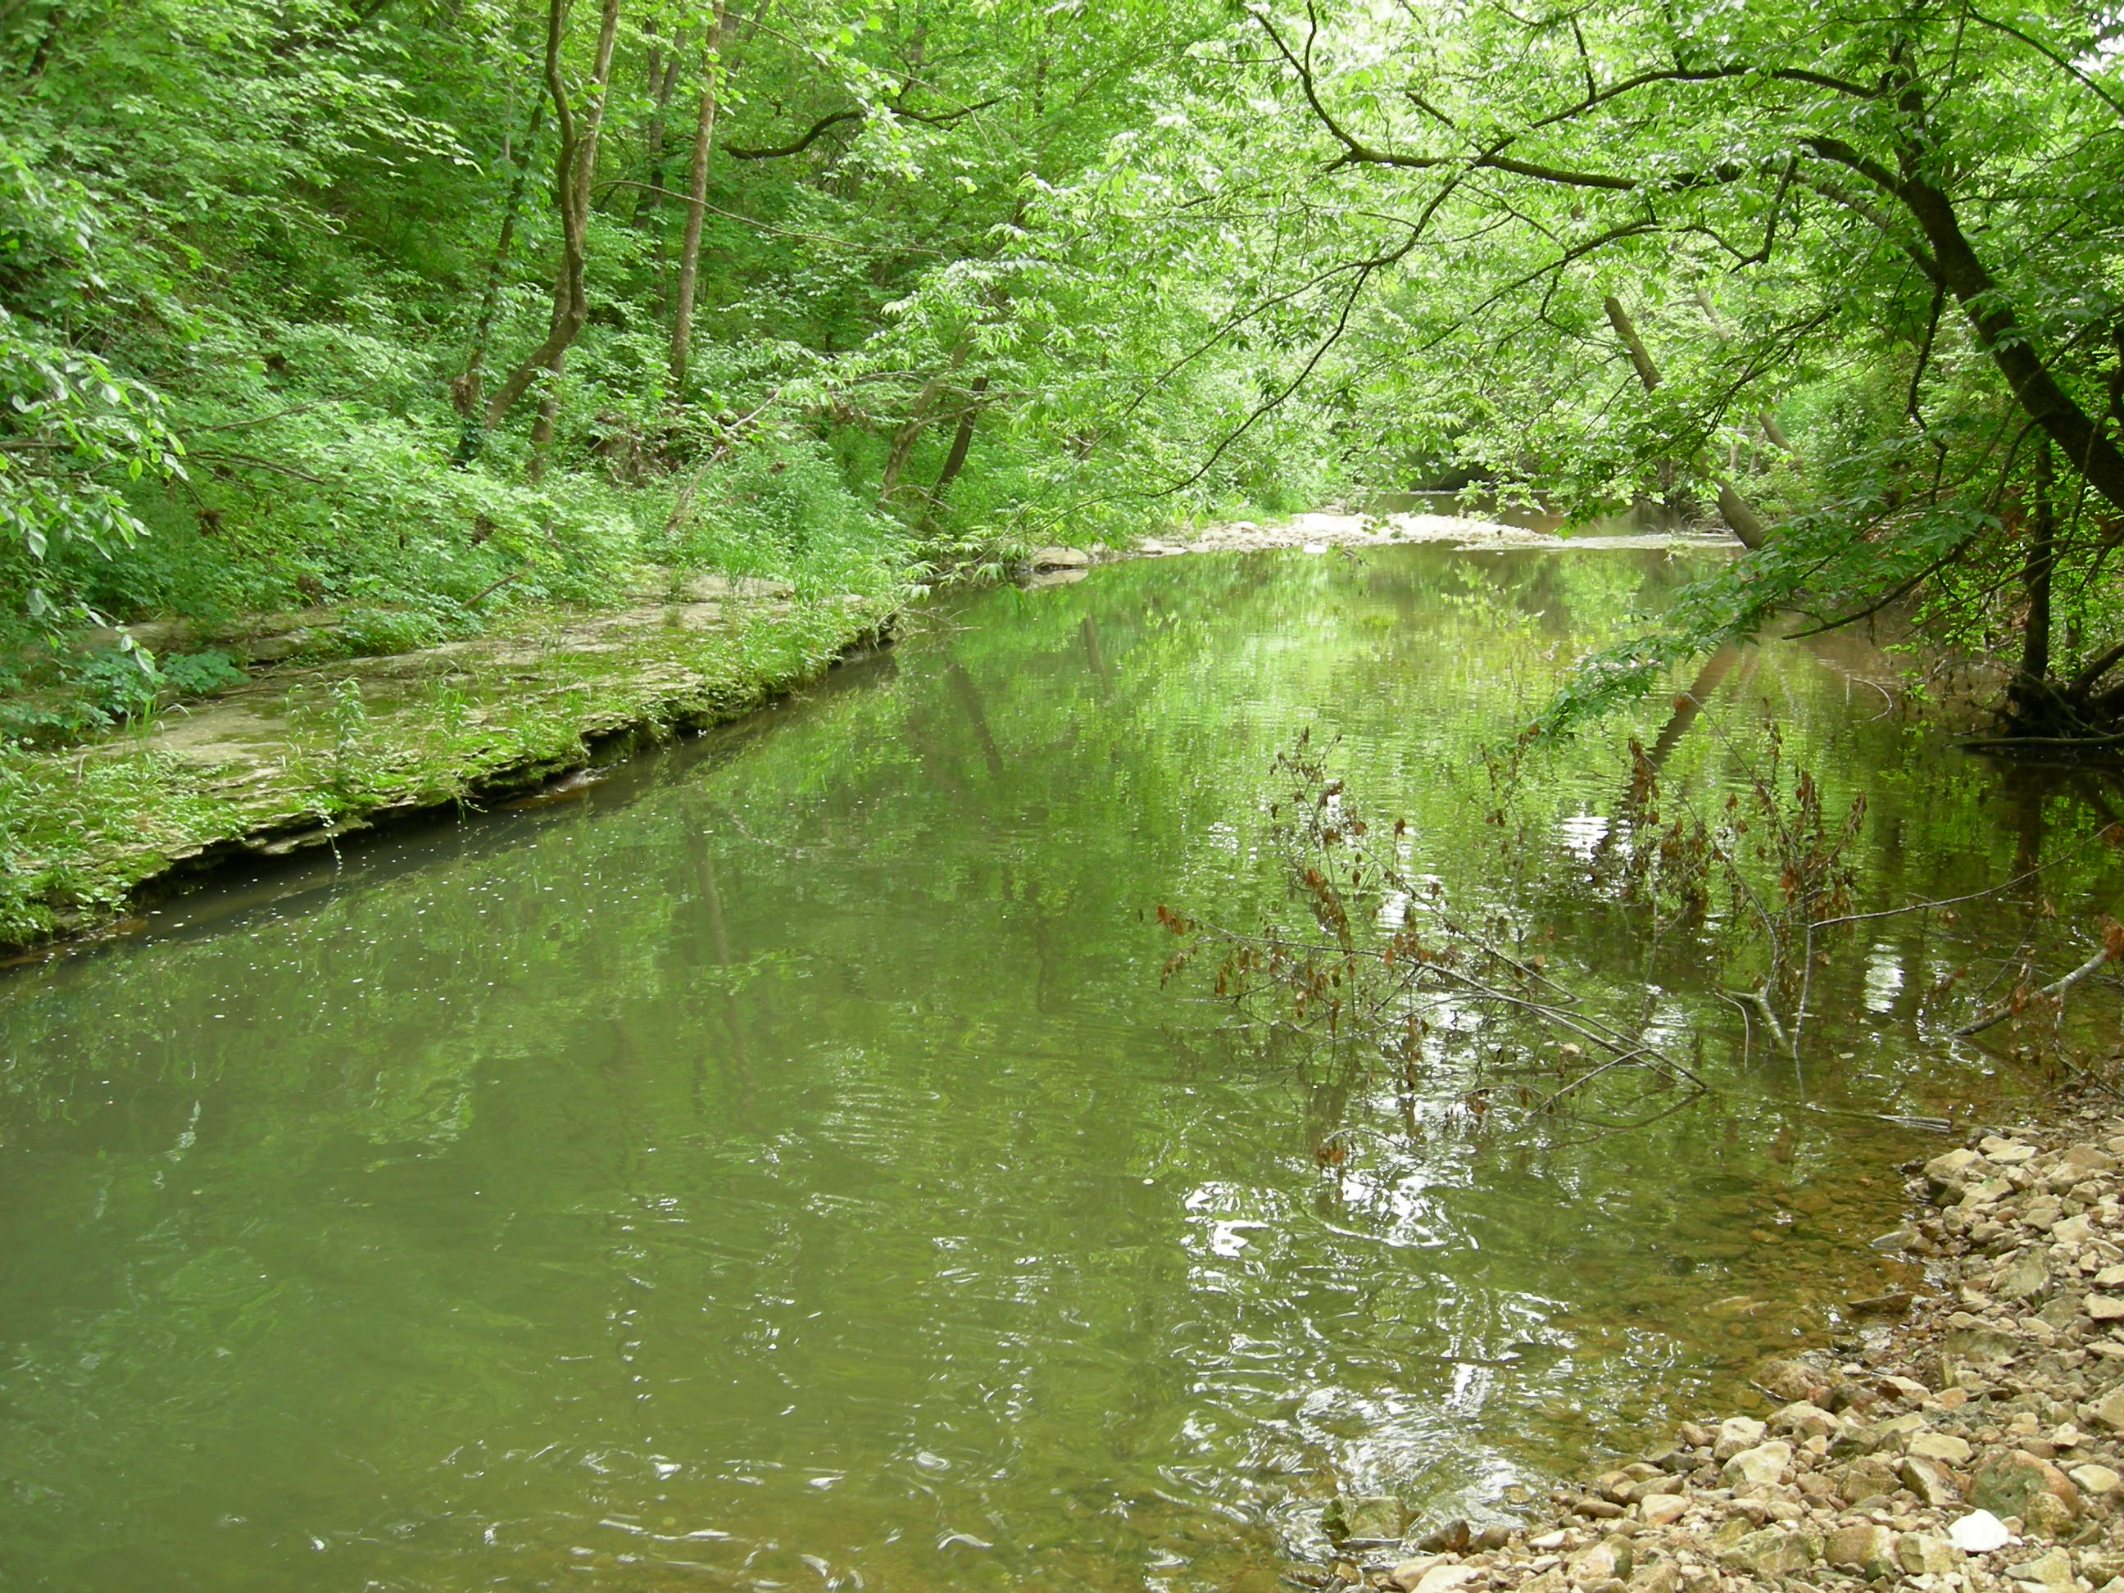
Load Determination
 | BCF | R²
NH₃ | 1.26-2.81 | 0.66-0.87
Cl | 1.01-1.10 | 0.78-0.98
NO₃ | 1.00-1.21 | 0.71-0.98
SRP | 1.01-1.65 | 0.84-0.98
SO₄ | 1.01-1.09 | 0.80-0.98
TN | 1.01-1.11 | 0.87-0.99
TP | 1.04-1.45 | 0.53-0.96
TSS | 1.06-6.48 | 0.75-0.93

Slide 6
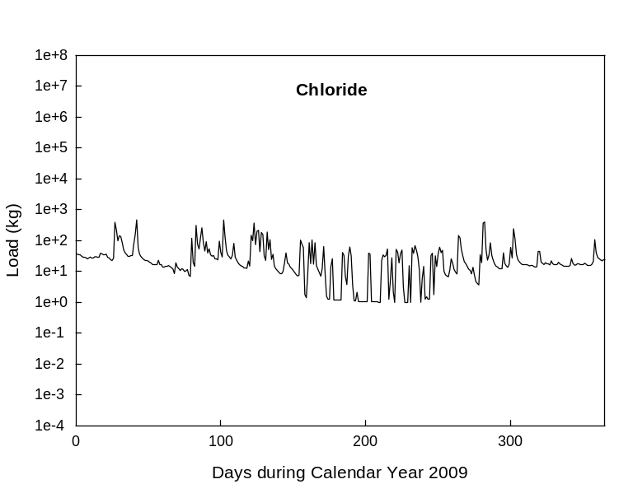
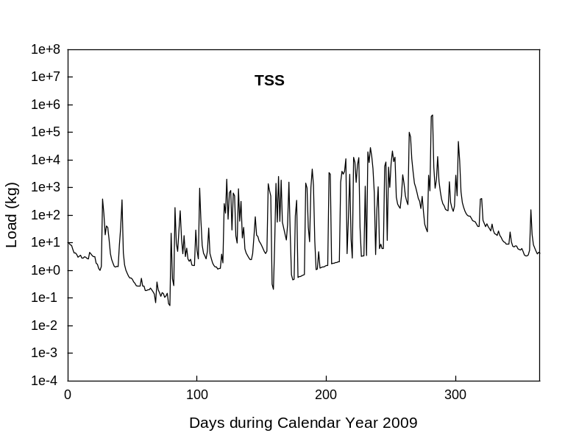
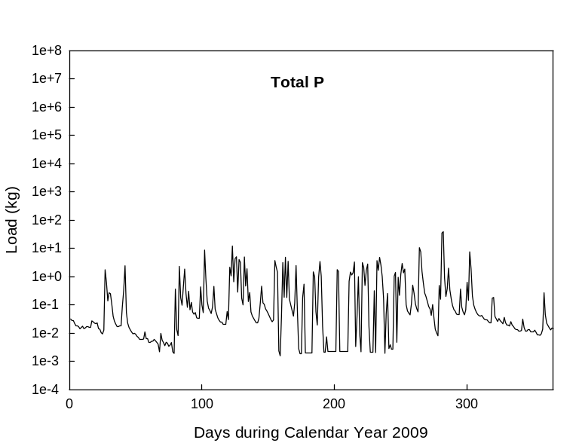
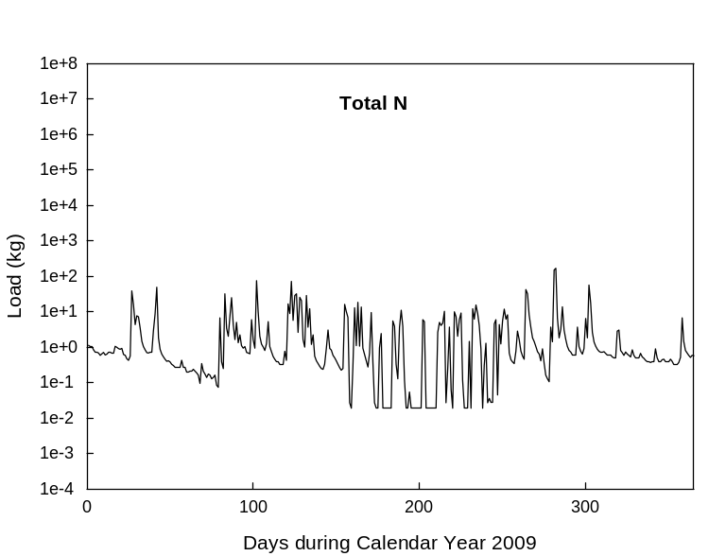
Daily loads were variable…
Illinois River at Highway 59

Slide 7
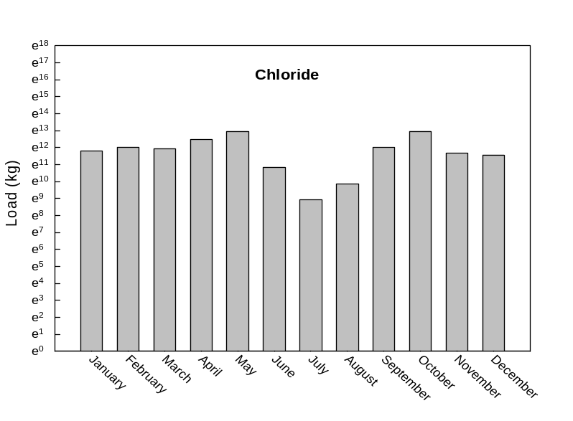
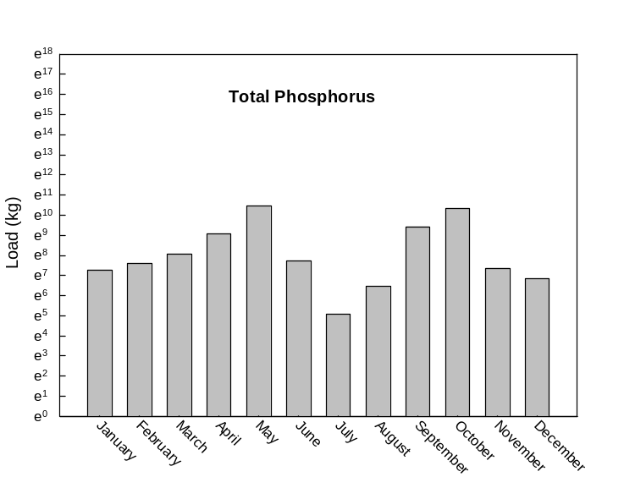
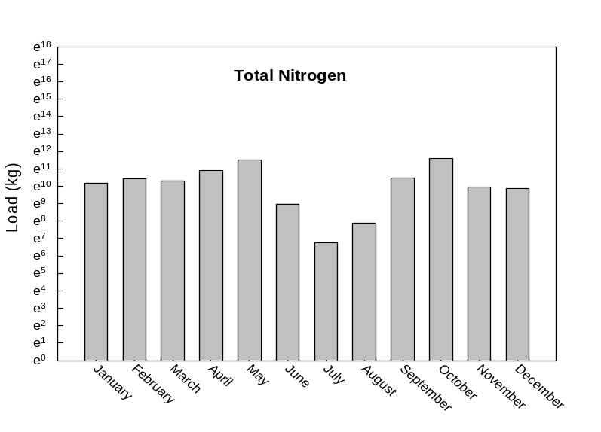
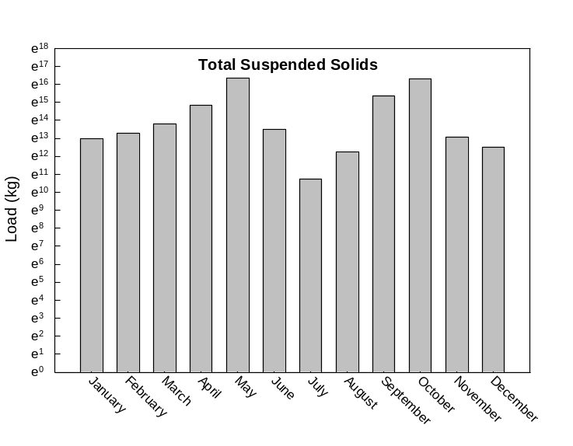
Monthly loads were least during drier, summer months…
Illinois River at Highway 59

Slide 8
Illinois River at Arkansas HWY59 is the watershed outlet…

Slide 9
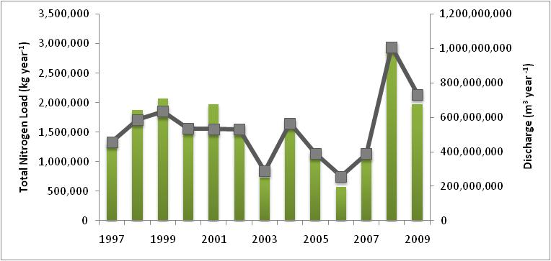
Annual Total Nitrogen Loads at watershed outlet

Slide 10
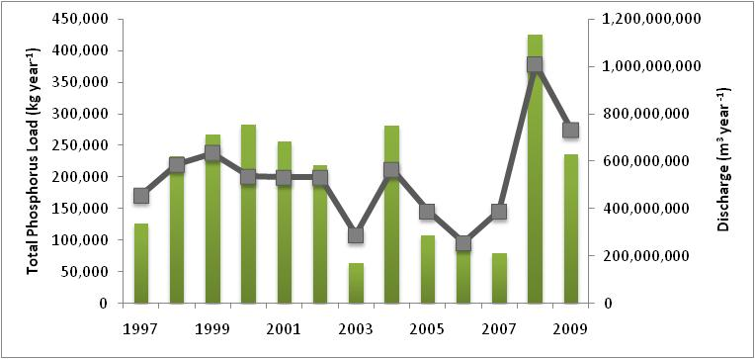
Annual Total Phosphorus Loads at watershed outlet

Slide 11
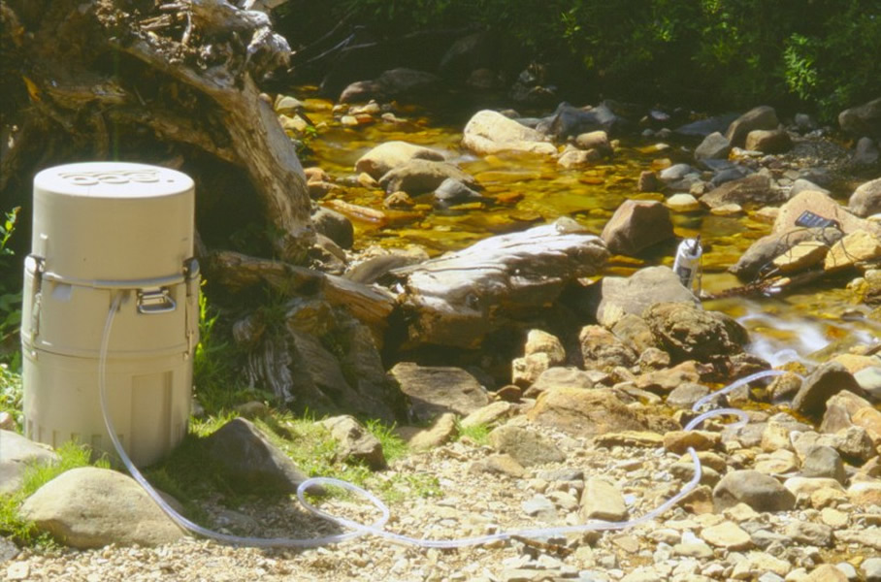
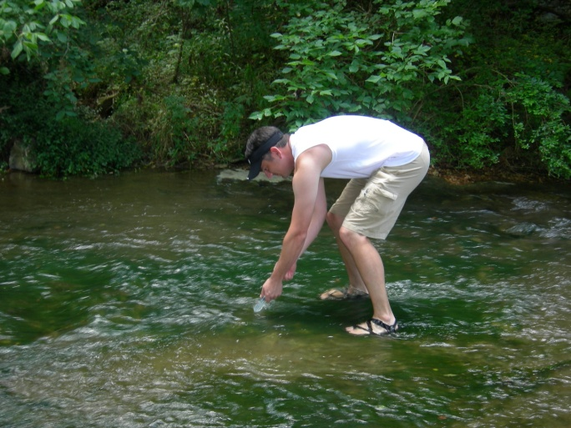
We changed sampling methods in July 2009.
Historically, loads have been estimated using autosamplers.
In July 2009, we switched to collecting grab samples to estimate loads.
We used the regression equations to predict loads from January 2009 to July 2009.
But we also had autosampler data from IR59 and Ballard Creek from this time period.

Slide 12
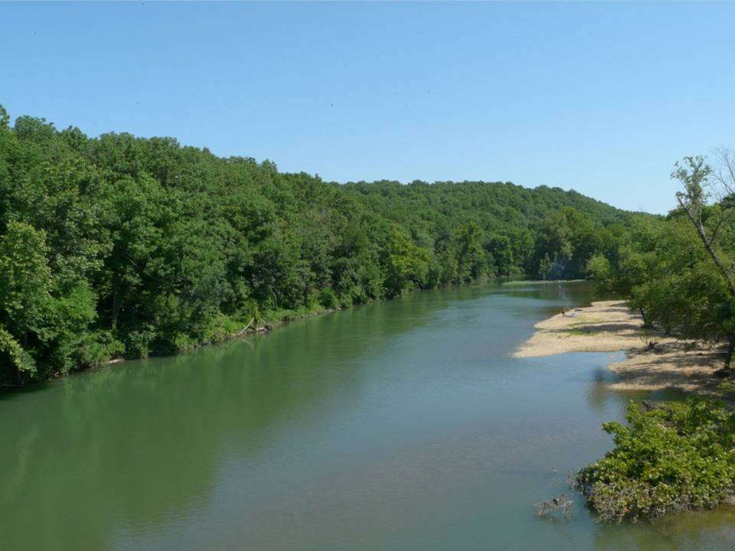
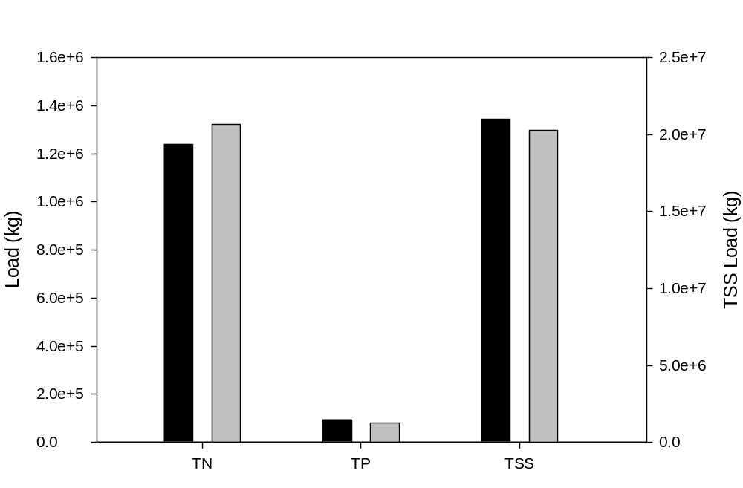
Variation between sampling methods at the watershed outlet…
Illinois River at AR59
7%
3%
16%

Slide 13
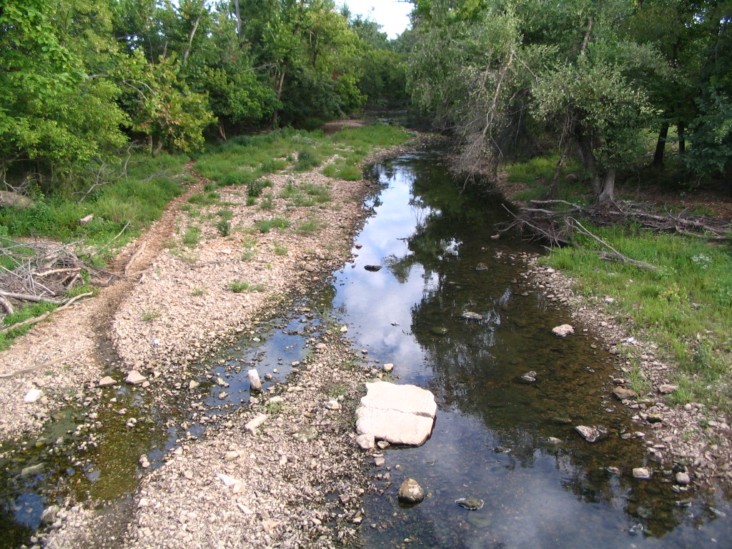
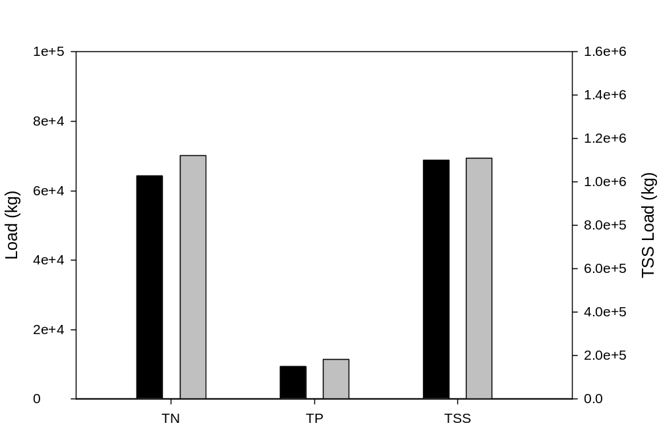
Variation between sampling methods at a smaller watershed…
Ballard Creek
9%
1%
22%

Slide 14
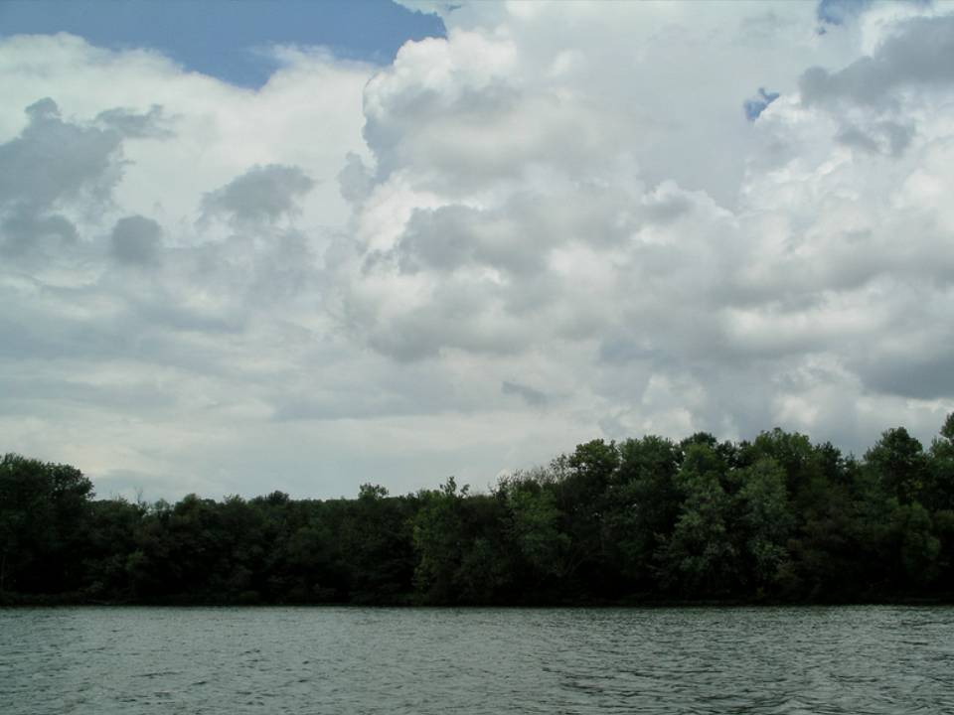
The monitoring program was successful at estimating loads within the Upper Illinois River Watershed.
The regression method produced loads similar to those estimated with the historic method..
  autosamplers and flow-weighted composites
The regression method allowed us to sample more sites across the watershed
  at about the same financial investment

